Slide 1
Linked .Net Users Group
LIDNUG – Proudly presents….
Ilija Injac
Azure Mobile Services Deep Dive

Slide 2







Sponsors
Many thanks for your ongoing support of our community…

Slide 3





LIDNUG Info
info@lidnug.org
www.twitter.com/lidnug
www.facebook.com/lidnug
Catch us if you can…
www.youtube.com/lidnug
Bit.ly/lidnug

Slide 4

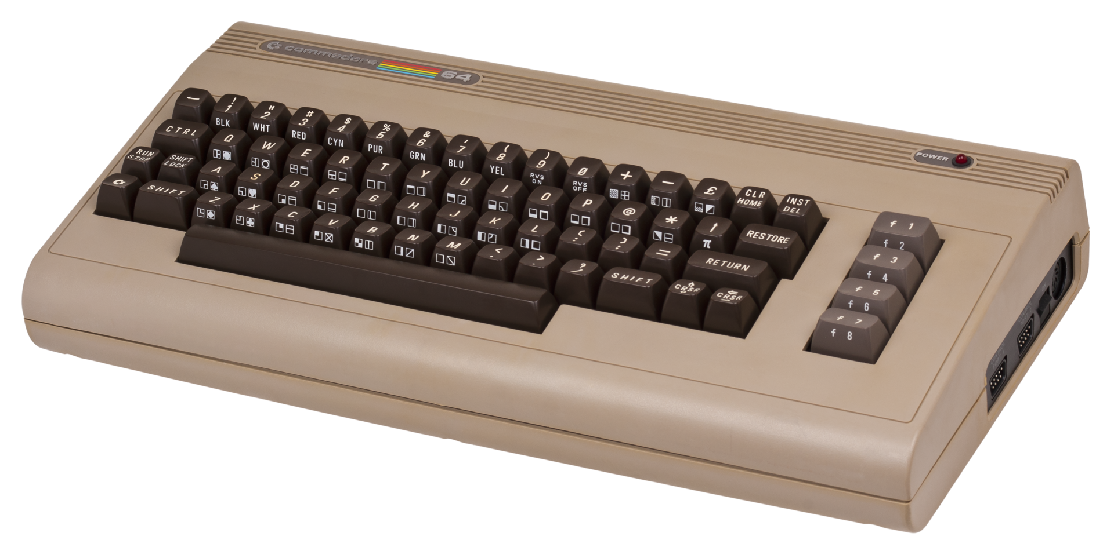
About me
-Developing software for about 15 years (I think even more)
-Worked for at least 5 years as a freelancer
-Started development on a C64, then Amiga and then PC (MS-DOS)
-Today a full MS-Stack developer, specialized on Windows Azure and the related technologies
-Married, one child
-Love all sorts of Marvel stuff, especially Iron Man
-Have my own company in Las Vegas, NV: ExGrip LLC
-Main Product: AppAdditives – helps Windows Phone developers to market their app
Source: Wikipedia

Slide 5


Contact details
Ilija Injac
Azure Mobile Services Deep Dive
ExGrip LLC: http://www.exgrip.com
AppAdditives: http://www.appadditives.com
Twitter: @awsomedevsigner
Blog: http://www.awsomedevsigner.com

Slide 6
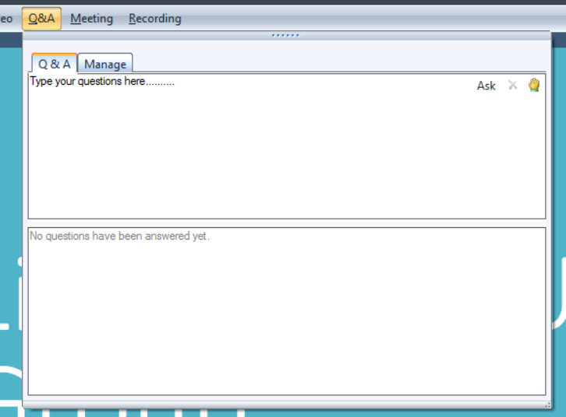
Asking questions of the Presenter?
Open the Q&A tab
Type in your question
You can only have 1 active question at a time…
Rule of thumb: Ask questions after the presentation. Thanks.

Slide 7
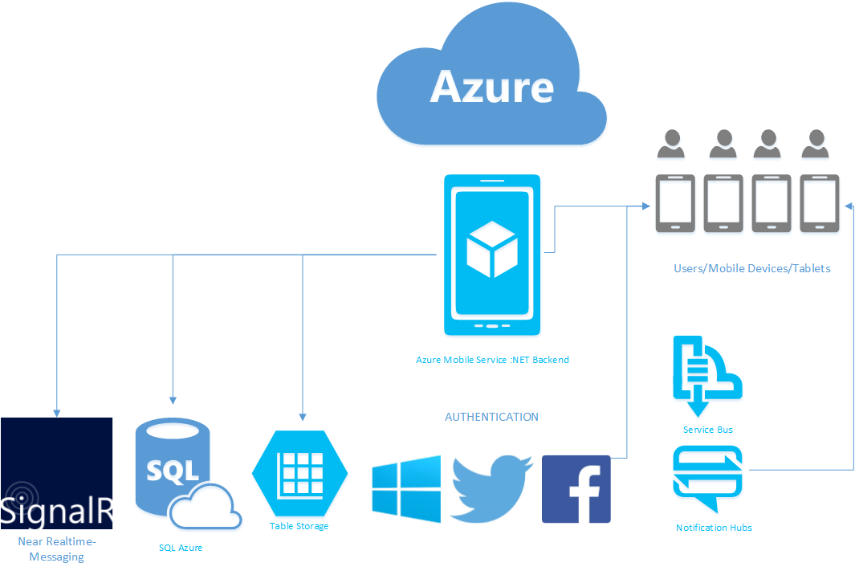
Mobile Services .NET
Base Architecture & Overview

Slide 8
Mobile Services .NET
ASP .NET Web API (REST Framework)
Entity Framework (ORM = Object Relational Mapper)
ApiController (CRUD Operations)
IIS HOSTING
SELF HOSTING
OWIN, KATANA & Web Api
Katana (MS Open Source implementation of OWIN)
OWIN (Open Web Interface for .NET)

Slide 9
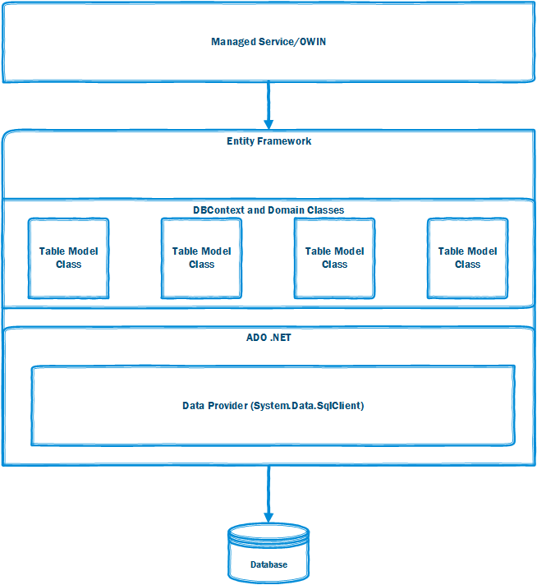
Mobile Services .NET
Entity Framework

Slide 10
Mobile Services .NET
OWIN/Web API Hosting/Configuration
Push Notifications / Notification Hubs / Service Bus
Dependency Injection (Autofac)
Hubs (SignalR) / Service Bus Backplane
Project Structure
Controllers
Scheduled Jobs
Model (Entity Framework, Code First)
DTO’s (Data Transfer Objects)
Database (SQL Server)

Slide 11
Mobile Services .NET
Mobile Services Project
Client App (Windows Store App)
Separate Assembly Existing
Database
Client POCO’s (Portable Class Library)
Sample Project – Basic Structure

